Slide 1
Chapter 1: What is Software Architecture?
Pingjian Zhang
School of Software Engineering, SCUT
2018

Slide 2
Chapter Outline
What Software Architecture Is and What It Isn’t
Architectural Structures and Views
Architectural Patterns
What Makes a “Good” Architecture?
Summary

Slide 3
What is Software Architecture?
The software architecture of a system is the set of structures needed to reason about the system, which comprise software elements, relations among them, and properties of both.

Slide 4
Other Definition
One of other definitions that talk about the system’s “early” or “major” design decisions.
vague

Slide 5
Architecture Is a Set of Software Structures
A structure is a set of elements held together by a relation.
Software systems are composed of many structures.
Module
Component and Connector
Allocation
Notes:
多重结构：人体组织

Slide 6
Module Structures
Structures partition systems into implementation units called modules.
Modules are assigned specific responsibilities, and are the basis of work.
Notes:
In large projects, these elements (modules) are subdivided for assignment to sub-teams.

Slide 7
Component-and-connector Structures
Structures focus on the way the elements interact with each other at runtime to carry out the system’s functions.
We call runtime structures component-and-connector (C&C) structures.
In our use, a component is always a runtime entity.
Notes:
Suppose the system is to be built as a set of services.
The services, the infrastructure they interact with, and the synchronization and interaction relations among them form another kind of structure often used to describe a system.
These services are made up of (compiled from) the programs in the various implementation units – modules

Slide 8
Allocation Structures
Allocation structures describe the mapping from software structures to the system’s environments
organizational
developmental
installation
Execution
For example
Modules are assigned to teams to develop, and assigned to places in a file structure for implementation, integration, and testing.
Components are deployed onto hardware in order to execute.
Notes:
Assignment and deployment become big issues when the metrics become huge.

Slide 9
Every Non-trivial System Has a Software Architecture
Every system comprises elements and relations among them to support reasoning.
But the architecture may not be known to anyone.
Perhaps all of the people who designed the system are long gone
Perhaps the documentation has vanished (or was never produced)
Perhaps the source code has been lost (or was never delivered)
Documentation is critical.

Slide 10
例子-项目管理软件的架构
项目管理模型（任务、期限、资源）需要以甘特图、html、文本文件等多种形式展现
甘特图的绘制可以用现有的类库，也可以定制开发
展现组件
绘制组件
模型组件

Slide 11
Structures and Views
A view is a representation of a structure.
For example, a module structure is the set of the system’s modules and their organization.
A module view is the representation of that structure, documented and used by some system stakeholders.
Architects design structures. They document views of those structures.

Slide 12
Module Structures
Elements are modules of some kind (classes, or layers, or divisions of functionality, etc.).
Modules are related to other modules by generalization or specialization relationships.
Modules use or depends on each other.
Module structures allow us to answer questions such as these:
What is the primary functional responsibility assigned to each module?
What other software does it use and depend on?

Slide 13
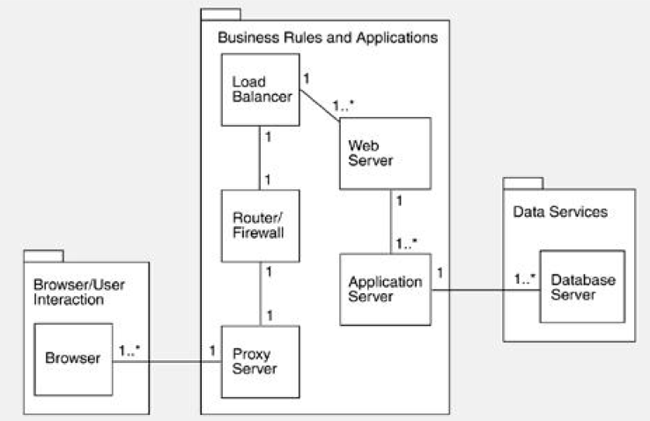
Example: Subsystems in the eBay Architecture

Slide 14
Component-and-connector Structures
Elements are runtime comopnents such as services, peers, clients, servers, filters, etc.)
Connector is the communication vehicle among components, such as call-return, process synchronization operators, pipes, or others.
Component-and-connector view helps us answer questions such as these:
What are the major shared data stores?
What part of the system can run in parallel?
Component-and-connector views are crucial for asking questions about the system’s runtime properties.
Notes:
What are the major executing components and how do they interact at runtime?
Which parts of the system are replicated?
How does data progress through the system?

Slide 15
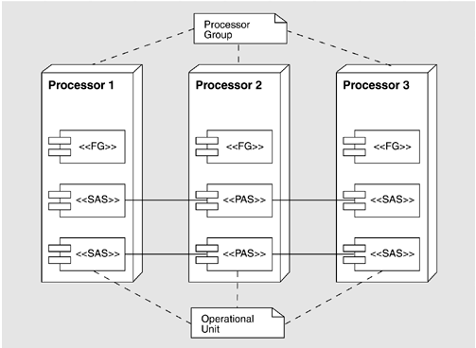
Example: Process View

Slide 16
Allocation Structures
Allocation views help us answer questions such as these:
What processor does each software element execute on?
In what directories or files is each element stored during development, testing, and system building?
What is the assignment of each software element to development teams?

Slide 17
Structures Provide Insight
The module structure, which embodies what modules use what other modules, is strongly tied to the ease with which a system can be extended or contracted.
The concurrency structure, which embodies parallelism within the system, is strongly tied to the ease with which a system can be made free of deadlock and performance bottlenecks.
The deployment structure is strongly tied to the achievement of performance, availability, and security goals.
Notes:
并发、互斥、占先、顺序、结果、资源、存在
通过部署提高性能、可用性、安全性

Slide 18
Some Useful Module Structures
Decomposition structure
The units are modules that are related to each other by the is-a-submodule-of relation.
The decomposition structure determines the system’s modifiability, by assuring that likely changes are localized.
This structure is often used as the basis for the development project’s organization, including the documentation, integration and test plans.

Slide 19
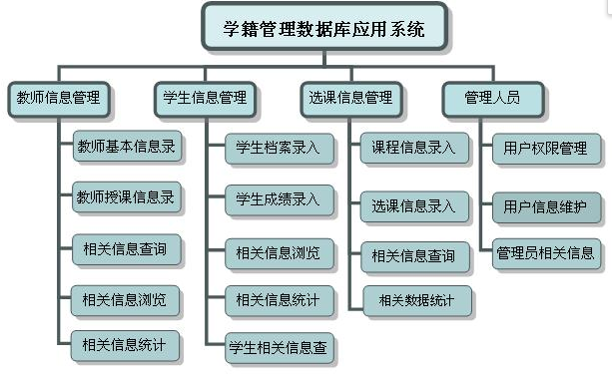
Example: Decomposition Structure

Slide 20
Some Useful Module Structures
Uses structure.
The units are related by the uses relation, a specialized form of dependency.
A unit of software uses another if the correctness of the first requires the presence of a correctly version of the second.
The uses structure is used to extend or contract systems.
The ability to easily create a subset of a system allows for incremental development.

Slide 21
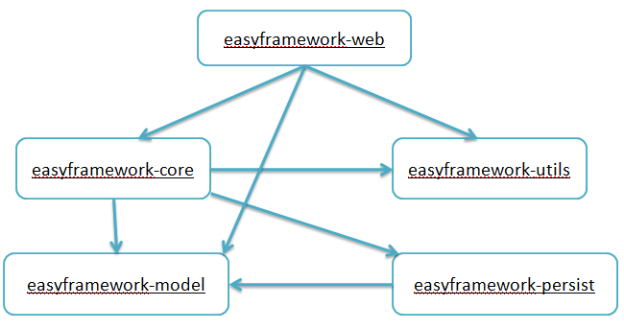
Example: Use Structure
Notes:
探索 MDA

Slide 22
Some Useful Module Structures
Layer structures
The modules in this structures are called layers.
A layer is an abstract “virtual machine” that provides a cohesive set of services through a managed interface.
Notes:
Java 虚拟机、云计算，Iaas，云虚拟机

Slide 23
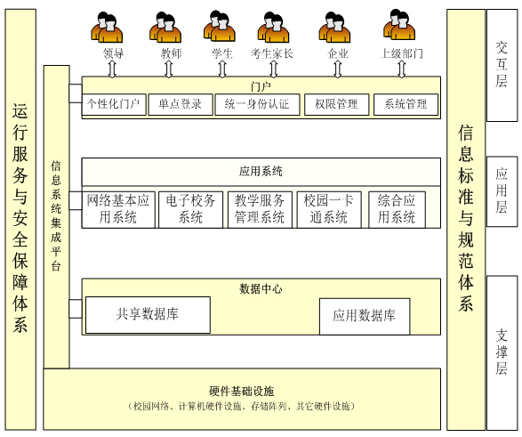
Example: Layer Structure

Slide 24
Some Useful Module Structures
Class (or generalization) structures
The module units in this structures are called classes.
The relation is inherits from or is an instance of or is composed of.
These views support reasoning about collections of similar behavior or capability
e.g., the classes that other classes inherit from and parameterized differences
The class structure allows one to reason about reuse and the incremental addition of functionality.

Slide 25
Some Useful Module Structures
Data model
The data model describes the static information structure in terms of data entities and their relationships.

Slide 26
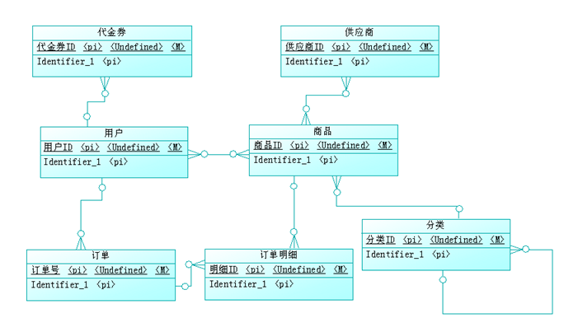
Example: Data Model

Slide 27
Some Useful C&C Structures
Useful C&C structures include:
Service structure
The units are services that interoperate with each other by service coordination mechanisms such as SOAP.
Concurrency structure
This structure helps determine opportunities for parallelism and the locations where resource contention may occur.

Slide 28
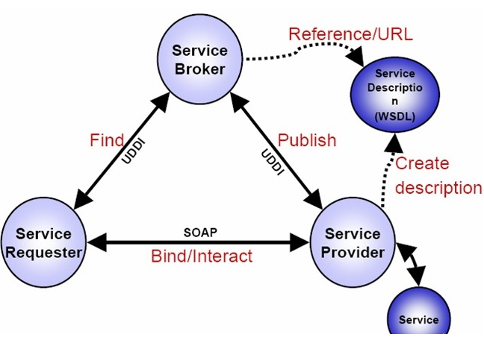
Example: Service Structure

Slide 29
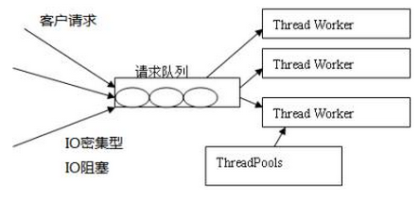
Example: Web Server

Slide 30
Some Useful Allocation Structures
Deployment structure
The deployment structure shows how software is assigned to hardware processing and communication elements.
The elements are software elements (usually a process from a C&C view), hardware entities (processors), and communication pathways.
Relations are allocated-to, showing on which physical units the software elements reside, and migrates-to if the allocation is dynamic.
This structure can be used to reason about performance, data integrity, security, and availability.
It is of particular interest in distributed and parallel systems.

Slide 31
Some Useful Allocation Structures
Implementation structure
This structure shows how software elements (usually modules) are mapped to the file structure(s) in the system’s development, integration, or configuration control environments.
Work assignment structure
This structure assigns responsibility for implementing and integrating the modules to the teams who will carry it out.

Slide 32
Relating Structures to Each Other
Elements of one structure can be related to elements of other structures.
A module in a decomposition structure may be manifested as one, part of one, or several components in one of the component-and-connector structures.
In general, mappings between structures are many to many.

Slide 33
Modules vs. Components

Slide 34
Architectural Patterns
The compositions of architectural elements are called architectural patterns.
Patterns provide packaged strategies for solving some of the problems facing a system.
An architectural pattern delineates the element types and their forms of interaction.
A common module type pattern is the Layered pattern.

Slide 35
Architectural Patterns
Common component-and-connector type patterns:
Shared-data pattern.
Client-server pattern.
The components are the clients and the servers.
The connectors are protocols and messages they share among each other to carry out the system’s work.

Slide 36
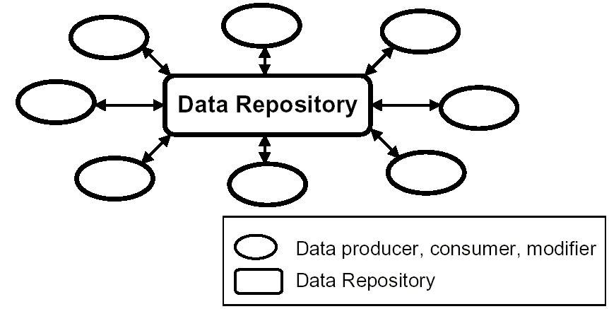
Example: Shared-data Pattern

Slide 37
Architectural Patterns
Common allocation patterns:
Multi-tier pattern.
Competence center pattern and platform pattern
These patterns specialize a software system’s work assignment structure.
In competence center, work is allocated depending on competence.
In platform, one site is tasked with developing reusable core assets of a software product line, and other sites develop applications that use the core assets.

Slide 38
What Makes a “Good” Architecture?
There is no such thing as an inherently good or bad architecture.
Architectures are either more or less fit for some purpose
Architectures can be evaluated but only in the context of specific stated goals.
There are, however, good rules of thumb.

Slide 39
Process “Rules of Thumb”
The architecture should be the product of a single architect or a small group of architects with an identified technical leader.
The architect (or architecture team) should base the architecture on a prioritized list of well-specified quality attribute requirements.
The architecture should be documented using views.
The architecture should be evaluated for its ability to deliver the system’s important quality attributes.
This should occur early in the life cycle and repeated as appropriate.
The architecture should lend itself to incremental implementation.
Notes:
The architecture should be the product of a single architect or a small group of architects with an identified technical leader.
This approach gives the architecture its conceptual integrity and technical consistency. This recommendation holds for Agile and open source projects as well as “traditional” ones.
There should be a strong connection between the architect(s) and the development team.
The architect (or architecture team) should base the architecture on a prioritized list of well-specified quality attribute requirements.
These will inform the tradeoffs that always occur.
Functionality matters less.
The architecture should be documented using views. The views should address the concerns of the most important stakeholders in support of the project timeline.
The architecture should be evaluated for its ability to deliver the system’s important quality attributes.
This should occur early in the life cycle, when it returns the most benefit, and repeated as appropriate.
The architecture should lend itself to incremental implementation,
Create a “skeletal” system in which the communication paths are exercised but which at first has minimal functionality.

Slide 40
Structural “Rules of Thumb”
The architecture should feature well-defined modules whose functional responsibilities are assigned on the principles of information hiding and separation of concerns.
Quality attributes should be achieved using well-known architectural patterns and tactics specific to each attribute.
The architecture should never depend on a particular version of a commercial product or tool.
Modules that produce data should be separate from modules that consume data.
Notes:
The information-hiding modules should encapsulate things likely to change
Each module should have a well-defined interface that encapsulates or “hides” the changeable aspects from other software

Slide 41
Structural “Rules of Thumb”
Every process should be written so that its assignment to a specific processor can be easily changed, perhaps even at runtime.
The architecture should feature a small number of ways for components to interact.
The architecture should contain a specific (and small) set of resource contention areas.

Slide 42
Summary
The software architecture of a system is the set of structures needed to reason about the system, which comprise software elements, relations among them, and properties of both.
A structure is a set of elements and the relations among them.
A view is a representation of a coherent set of architectural elements. A view is a representation of one or more structures.

Slide 43
Summary
There are three categories of structures.
Structures represent the primary engineering leverage points of an architecture.
Every system has a software architecture, but this architecture may be documented and disseminated, or it may not be.
There is no such thing as an inherently good or bad architecture. Architectures are either more or less fit for some purpose.

